Slide 1

B₂ Integrals from Urqmd and comparison to sum rule.
This presentation shows Urqmd test of balance function integration, comparing to the ‘sum rule’.
The code tested here is also used to analyze data.
Since this simulation has no tracking inefficiency, centrality is exactly known, no particle misidentification, no track crossing effects etc. these clinical comparisons lead to very precise tests.
Nandita Raha and Launa Di Carlo
RHIG Group Meeting
01/24/2022

Slide 2
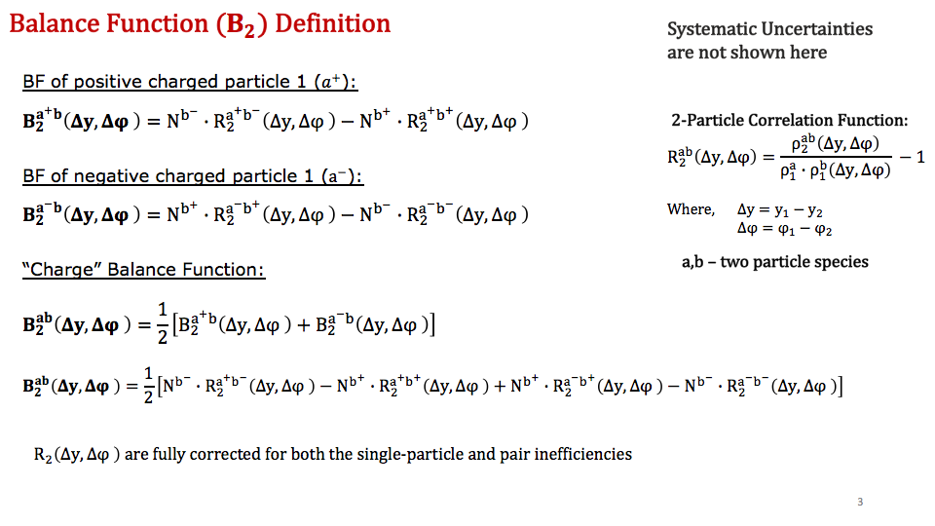
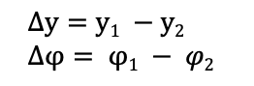
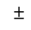
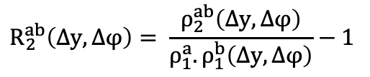
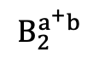
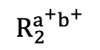



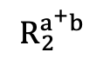

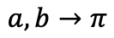
Balance Function (B₂ ) Definition and Integral of B₂
$±$
$$±$$
We calculate differential B₂(dy,dφ) using prefactors and R₂ and then integrate the resulting histogram
Balance Function (B₂ ) Definition
2-particle correlation function:
$$±$$
$$R_{2}^{ab}\left(∆y,∆φ\right)= \frac{ρ_{2}^{ab}\left(∆y,∆φ\right)}{ρ_{1}^{a}.ρ_{1}^{b}\left(∆y,∆φ\right)}−1$$
Integral of B₂
$$±$$
Integral of B₂ evaluated as sum of bin contents divided by the number of bins B₂(dy,dφ) distribution.
$$±$$
$$∆y=y1 −y2$$
$∆φ= φ1 − φ2$
a,b – two particle species
$$a,b→π$$
$$R_{2}^{a^{+}b^{+}}$$
$$B_{2}^{a^{+}b}$$
$$R_{2}^{a^{+}b}$$
200 GeV Au Au for 0-5% centrality, Urqmd for π

Slide 3
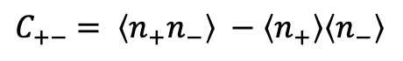

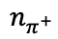
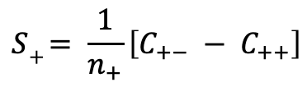
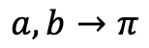
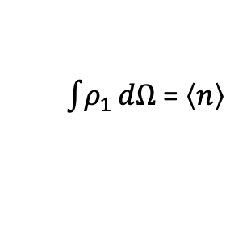
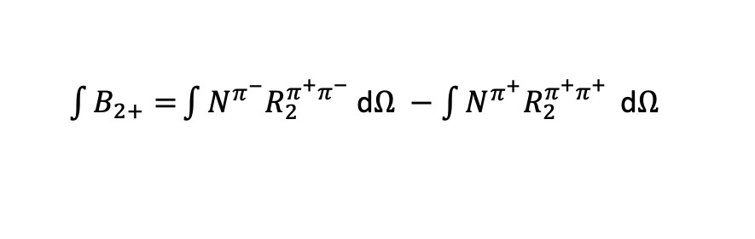
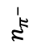
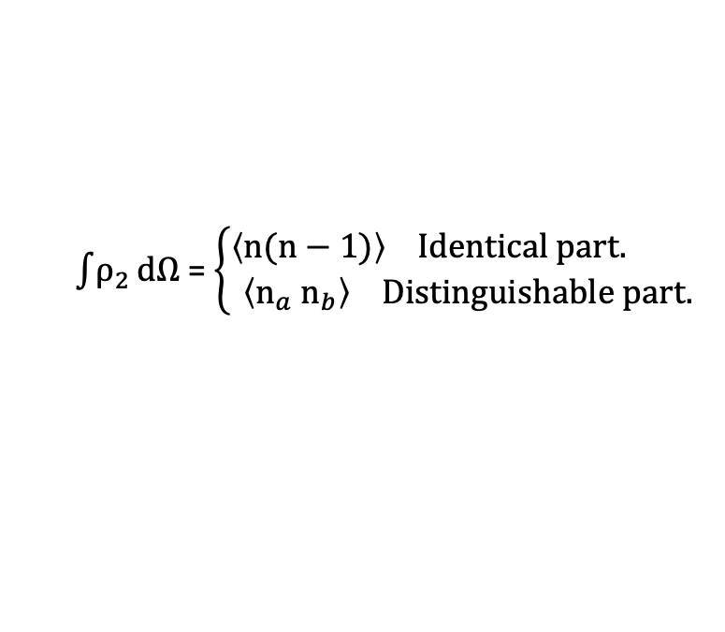
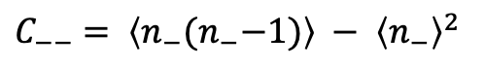
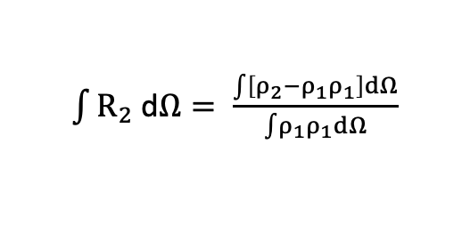
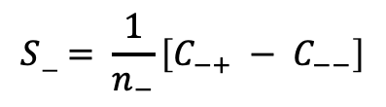
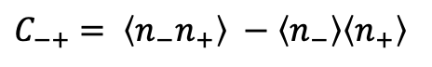
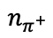
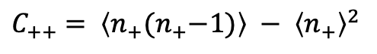
Integral of B₂ from sum rule
$±$
We also calculate the balance function integral using only the multiplicity distribution of the event ensemble.
From the definition of B₂+, we have
$$n_{π^{−}}$$
Au Au at 200 GeV
$\int{B_{2+}=}\int{N^{π^{−}}R_{2}^{π^{+}π^{−}} }$d$Ω −\int{N^{π^{+}}R_{2}^{π^{+}π^{+}} }\text{d}Ω$
$$a,b→π$$
0-5%, Urqmd
Assuming, the integral of a ratio R₂ = ratio of integrals (boost invariance)
$\int{ρ_{2}}dΩ$ = $\left\{\begin{aligned}\left\langle n(n−1)\right\rangle Identical part. \\ \left\langle n_{a}{ n}_{b}\right\rangle Distinguishable part.\end{aligned}\right.$
$\int{R_{2} }$d$Ω= \frac{\int{\left[ρ_{2}−ρ_{1}ρ_{1}\right]dΩ}}{\int{ρ_{1}ρ_{1}}dΩ}$
$\int{ρ_{1}}dΩ$ = $\left\langle n\right\rangle$
$$n_{π^{+}}$$
$C_{+−}$ $= \left\langle n_{+}n_{−}\right\rangle −\left\langle n_{+}\right\rangle \left\langle n_{−}\right\rangle$
$C_{−+}$ $= \left\langle n_{−}n_{+}\right\rangle −\left\langle n_{−}\right\rangle \left\langle n_{+}\right\rangle$
$C_{++}$ $= \left\langle n_{+}{(n}_{+}−1)\right\rangle − {\left\langle n_{+}\right\rangle }^{2}$
$C_{−−}$ $= \left\langle n_{−}{(n}_{−}−1)\right\rangle − {\left\langle n_{−}\right\rangle }^{2}$
No. of evt.
B₂ +
B₂ -
$$S+ = \frac{1}{n_{+}}\left[C_{+−} − C_{++}\right]$$
$$S− = \frac{1}{n_{−}}\left[C_{−+} − C_{−−}\right]$$
Detailed steps in the back-up.
$$n_{π^{+}}$$

Slide 4

Comparing B₂ Integrals from R₂ with Sum Rule – 200 GeV
Sum Rule
B₂ from R₂
B₂₊
The urqmd test indicates that the analysis code produces the same BF integral from two very different approaches
it shows that we are integrating our 2D BFs built from R₂s correctly
we are using the same code for the STAR data
75-80%
0-5%
75-80%
0-5%
75-80%
0-5%
B₂₋
75-80%
0-5%
75-80%
0-5%
75-80%
0-5%

Slide 5
Summary
Urqmd test with balance function integration compares very well to the ‘Sum Rule’.
This precisely tests that we are integrating our balance functions correctly.
In progress: We are working on applying this for STAR data.

Slide 6
Back-Up

Slide 7
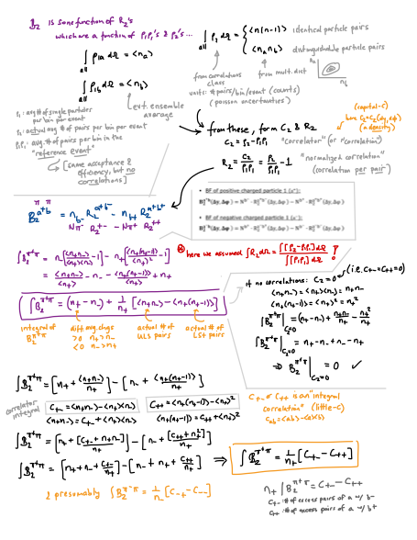
Bill’s Derivation:
P1
P3

